Slide 1
Crop Production in India Analysis
File created on: 3/31/2024

Slide 2
KEY PERFORMANING INDICATORS
Yield per Hectare/Acre: This KPI measures the quantity of crop produced per unit of land area. It provides insight into the productivity of the farming operation.
Crop Growth Stage Monitoring: Tracking the progress of crop growth stages helps in timely management decisions such as irrigation scheduling, pest control, and harvesting.
Regional Analysis: Examine the geographical distribution of crop production across different states. Identify key regions contributing significantly to overall production.
Crop-wise Insights: Delve into the production of specific crops and their contribution to overall agriculture output. Discuss any shifts or trends observed in the cultivation of different crop types.

Slide 3
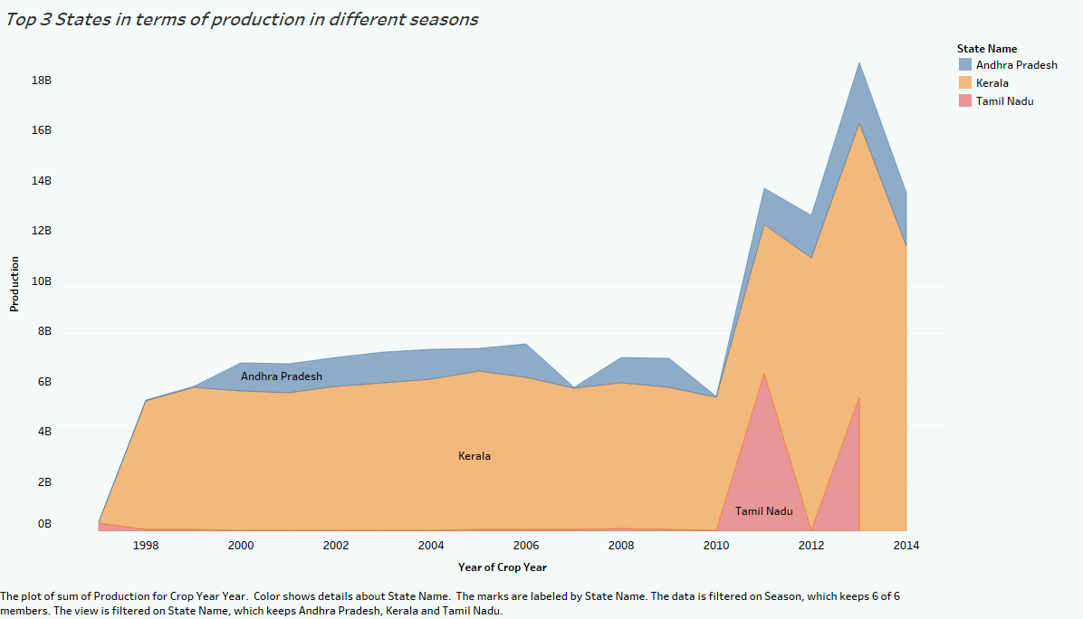

Slide 4
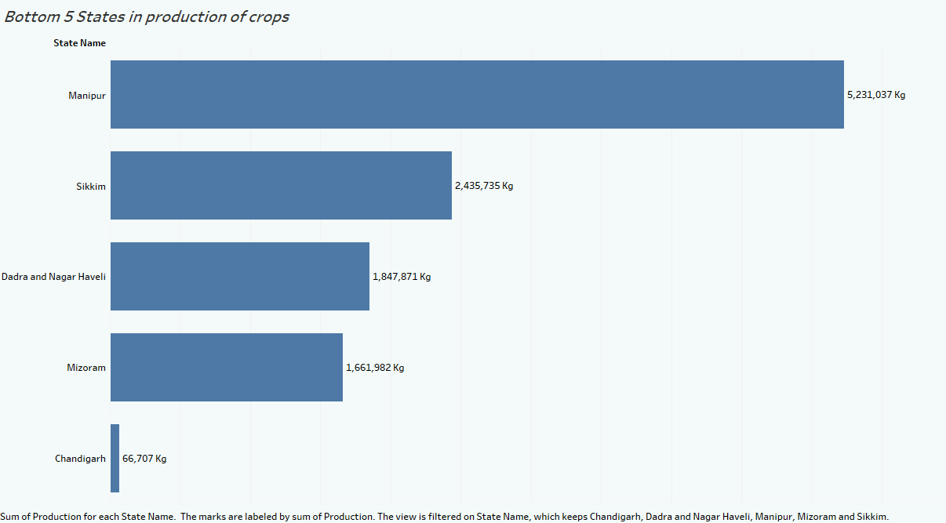

Slide 5
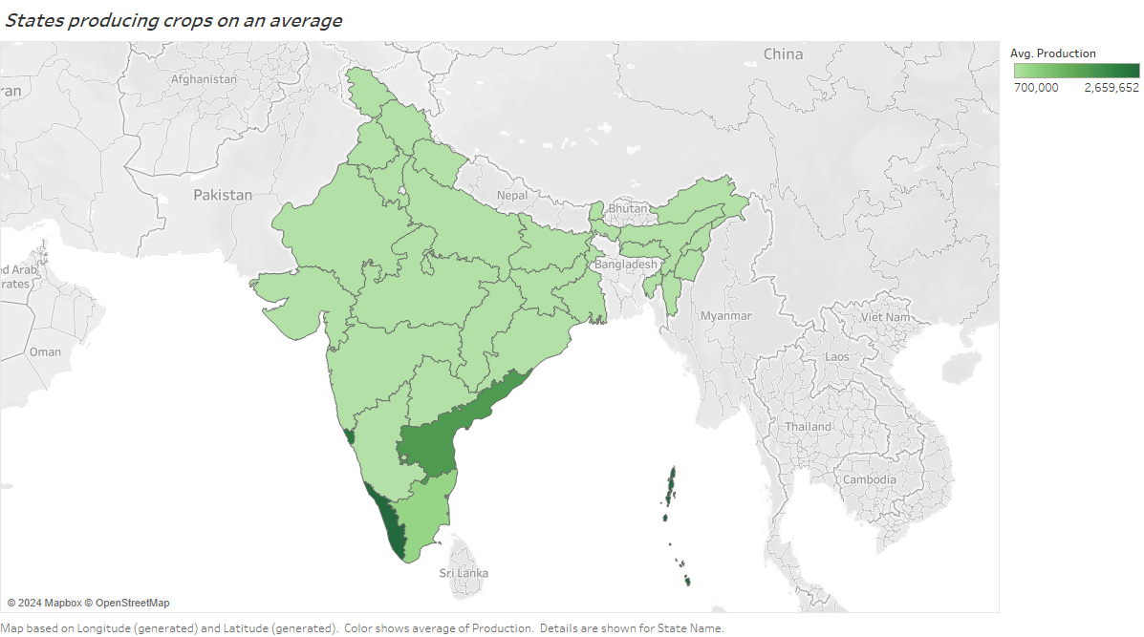

Slide 6
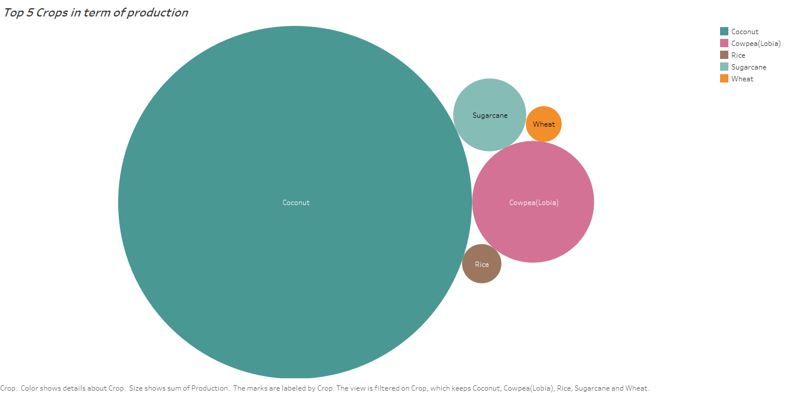

Slide 7
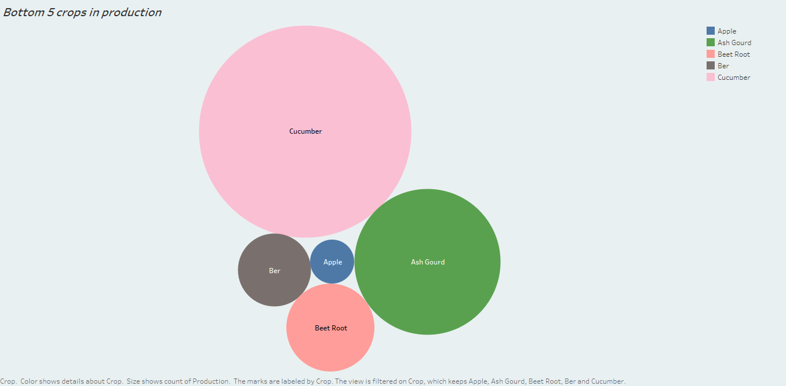

Slide 8
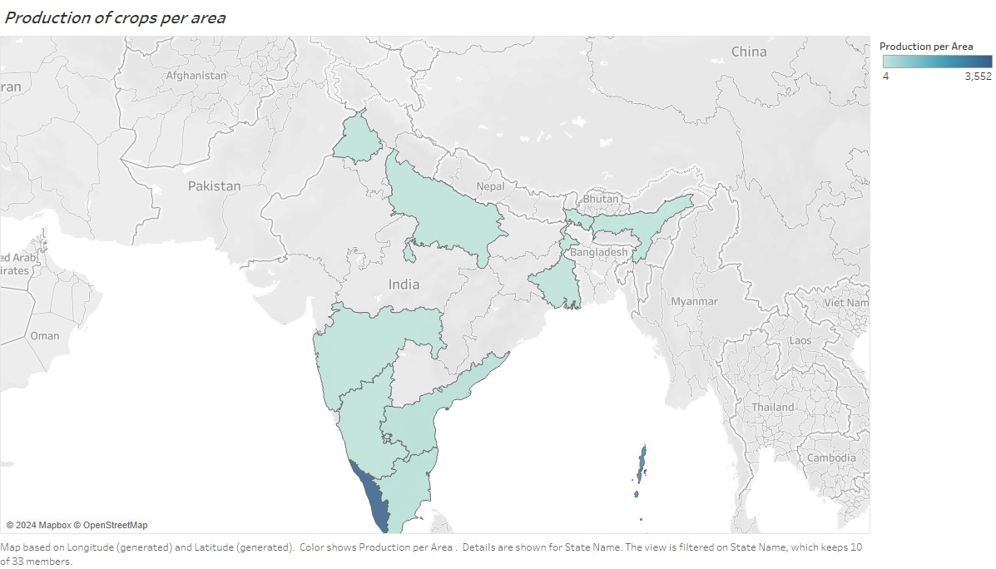

Slide 9
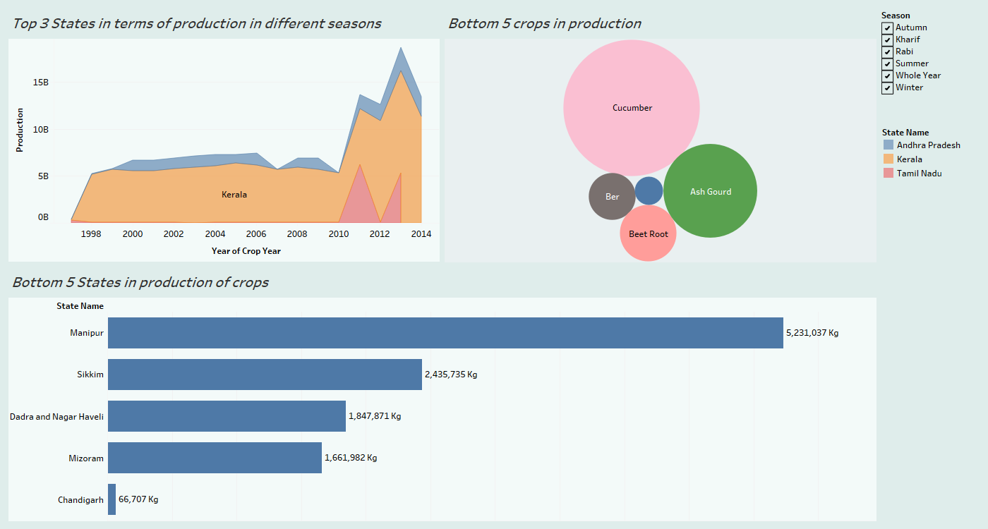

Slide 10
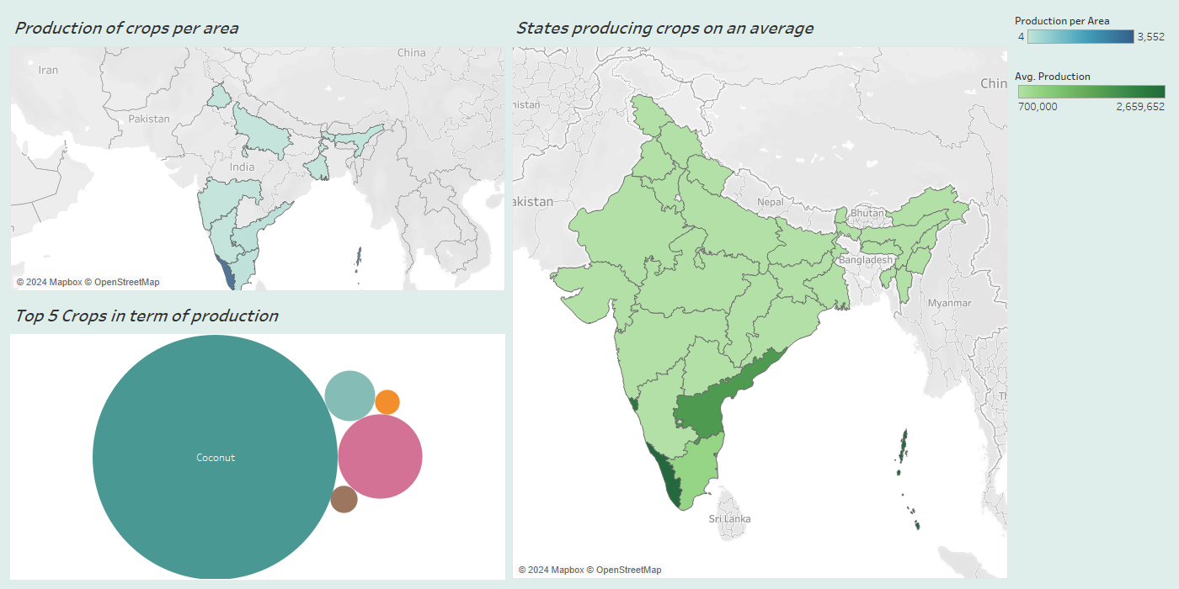

Slide 11
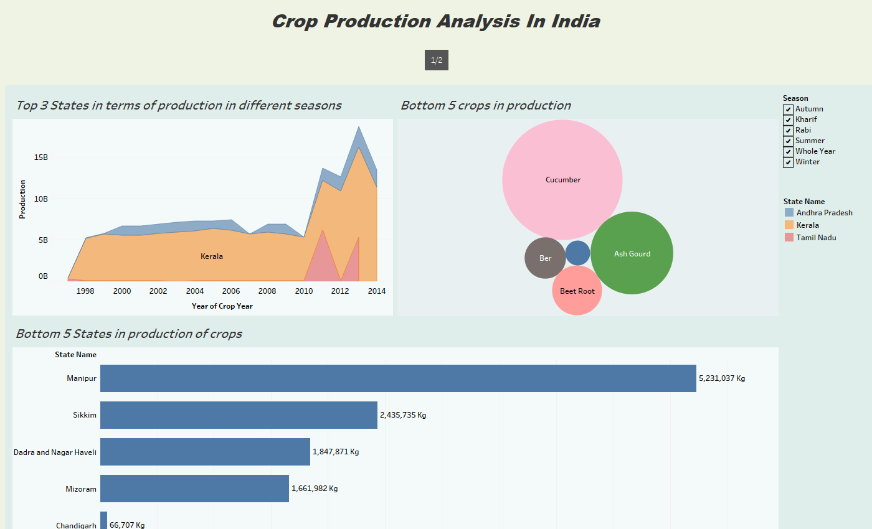

Slide 12
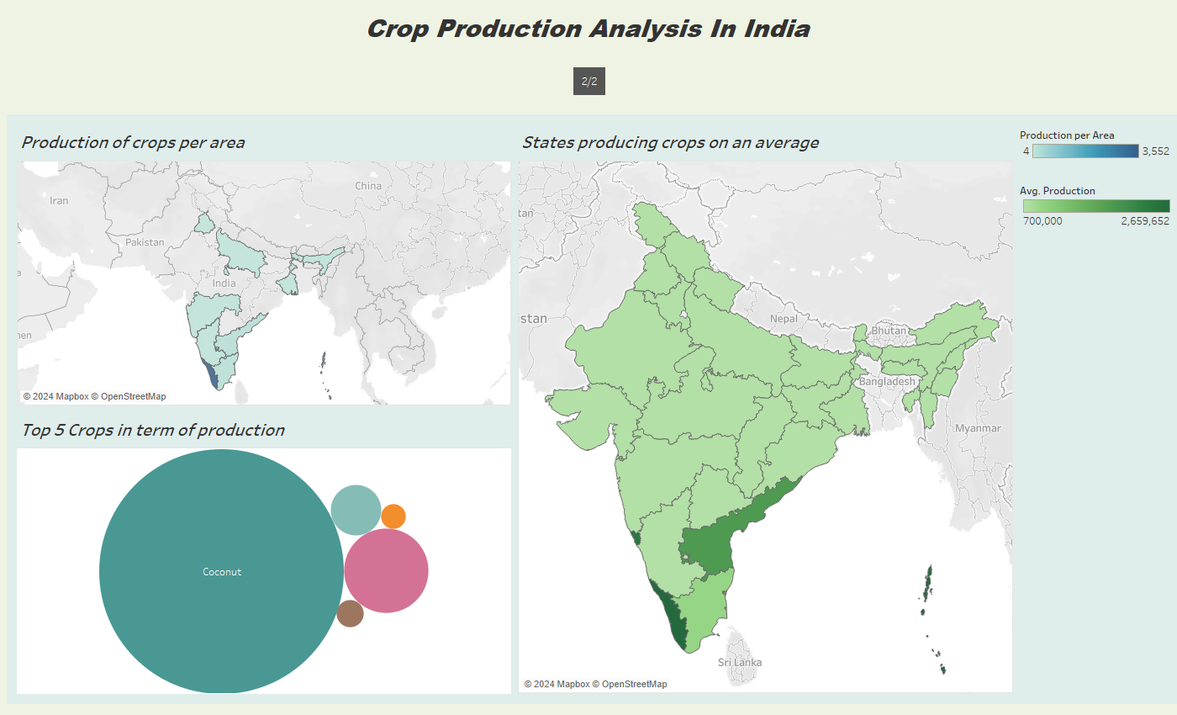

Slide 13
THANK YOU

